Slide 1
Software Propose
Optimizing NHANES Data Utilization
Challenges and Opportunities
Andre Rico
IBI - App Dev

Slide 2
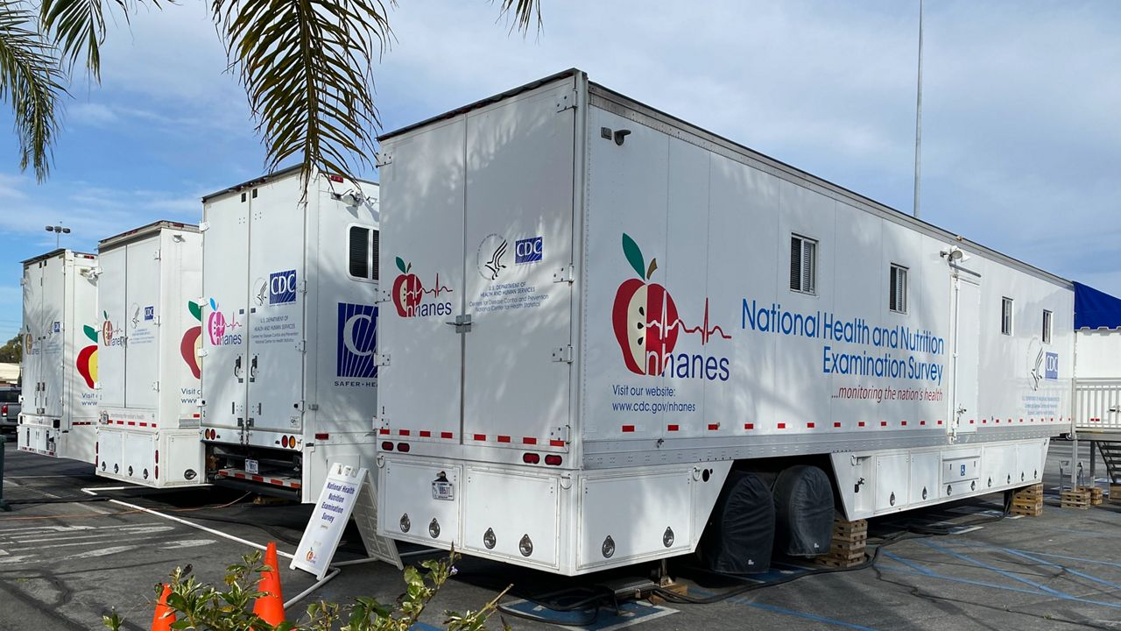
National Health and Nutrition Examination Survey (NHANES)
Objective + Methodology
NHANES is a program of studies designed to assess the health and nutritional status of adults and children in the United States.
Objective The primary objective of NHANES is to collect data that can be used to determine the prevalence of major diseases and risk factors for diseases, and to monitor trends in health and nutrition over time.
Methodology NHANES combines interviews and physical examinations. The interviews include questions about demographics, socioeconomics, diet, and health. The physical examinations include medical, dental, and laboratory tests performed by trained health professionals.

Slide 3
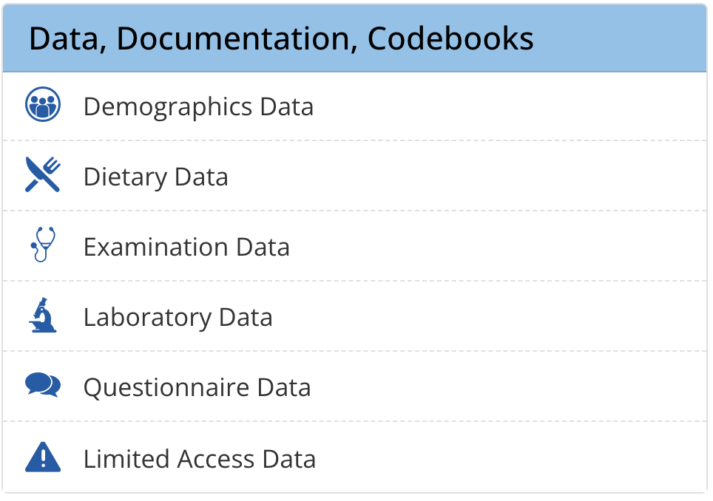

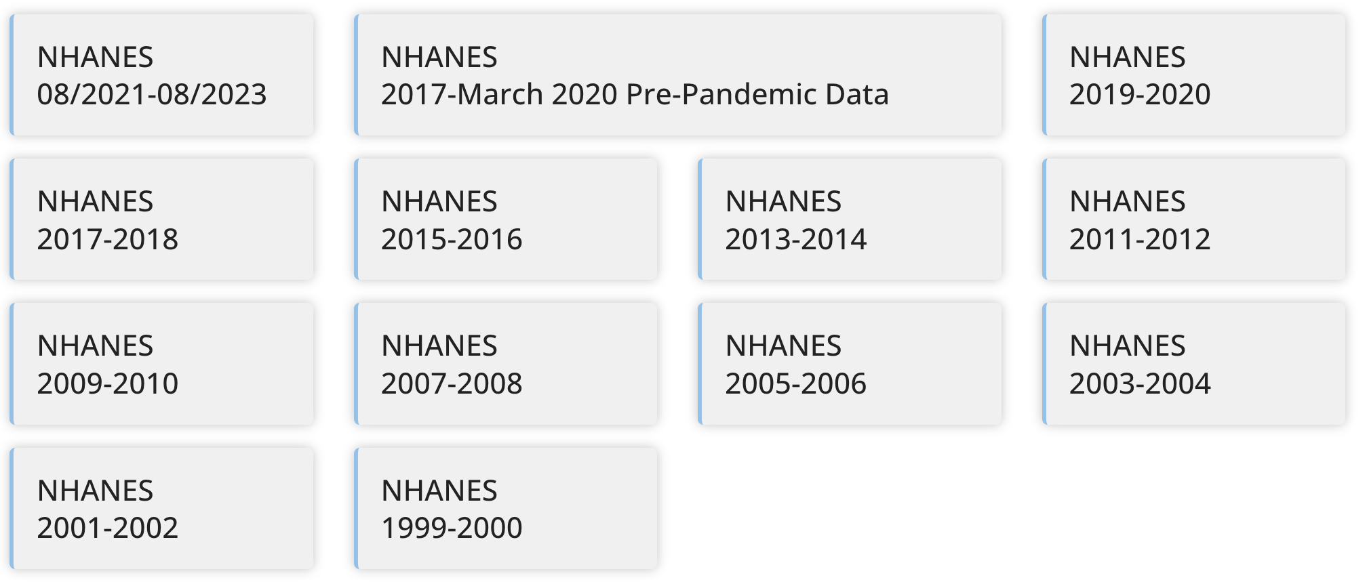

Slide 4
NHANES Data
Key Aspects of nhanes data management
Valuable Data
NHANES provides comprehensive data on health and nutrition.
Includes demographics, dietary information, health conditions, laboratory results, and more.
Essential for public health research, policy-making, and setting health standards.
Exploration Challenges
Fragmented data: Each cycle and category must be individually accessed and processed.
Requires specialized tools (like SAS) or conversion to more accessible formats (CSV, SQL, etc.).
Time-consuming and resource-intensive to integrate and analyze data across multiple cycles and categories.
Initiatives
Harmonized US National Health and Nutrition Examination Survey 1988-2018 for high throughput exposome-health discovery
https://www.ncbi.nlm.nih.gov/pmc/articles/PMC9934713/
Challenges and Lessons Learned in Generating and Interpreting NHANES Nutritional Biomarker Data
https://www.ncbi.nlm.nih.gov/pmc/articles/PMC5347107/

Slide 5







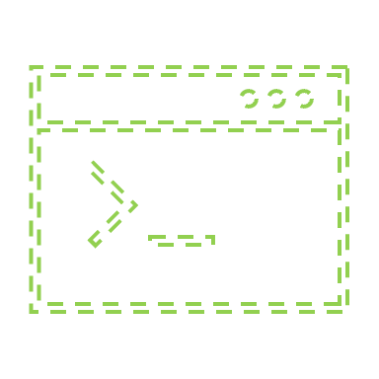
Why Not?
Publications
Common Normalization Rules Area
NHANES
Control, Load and Aggregation
Raw Data
Normalized Data
XPT
Query
User Analysis

Slide 6
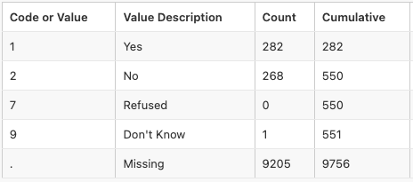
Examples of Common Normalization Rules Area
7
9
missing
Normalize Values
LDL
STALIN
LDL-N
Apply a rationale (LDL / 0.8) to participants that use statin.
Diff HDL Approach over the years
HDL 1999
HDL 2006
HDL 2018
Apply a rationale rule to consolidate
HDL
HDL
Single HDL Field
HDL
Normalize measurements that have had procedural changes over the years.

Slide 7
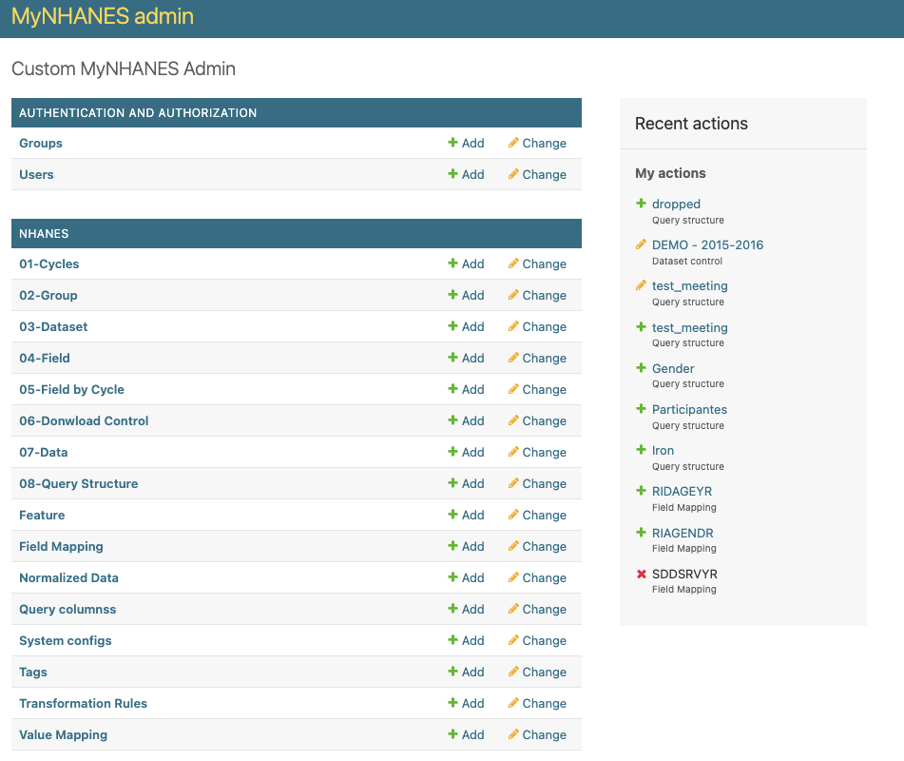
MyNHANES
Potential Benefits:
Establish a reference for researchers utilizing NHANES data.
Integrate with ML and AI technologies.
Provide data accessible on cloud platforms.
Consider this: NHANES already conducts laboratory tests. What would be the barrier to get genetic data to all participants in the future? (Rich research data source + Genome)¹
Simple way to get NHANES data
Python + SQLite
Install
Setup
Load
Query
¹ https://www.cdc.gov/nchs/nhanes/biospecimens/dnaspecimens.htm

Slide 8

Discussion
It is feasible and worth pursuing
It is feasible but beyond the current scope or priority of the laboratory
This idea is far-fetched
Select and drag to the option chosen by the team

Slide 10





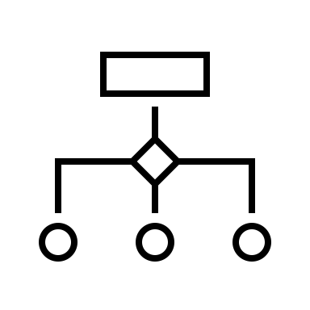
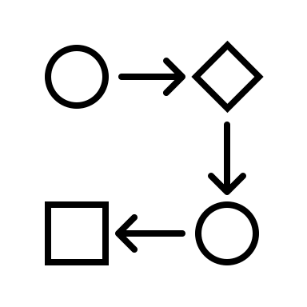
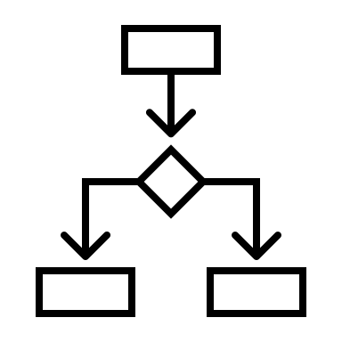

Common Normalization Rules Area
Rule 1
Rule 3
Rule 2
Rule N
Raw Data
Normalized Data
Dataset | Variable
da_a | var_1
ds_b | var_1
ds_b | var_2
ds_b | var_3
Variable
var_1
var_2
var_2_N
var_3

Slide 11
Examples of Common Normalization Rules Area
Age in DS A
Age in DS B
Age
Aggregate fields that are repeated in different files.
LDL
STALIN
LDL-N
Apply a rationale (LDL / 0.8) to participants that use statin.
Diff HDL Approach over the years
HDL 1999
HDL 2006
HDL 2018
Apply a rationale rule to consolidate
HDL
HDL
Single HDL Field
HDL
Normalize measurements that have had procedural changes over the years.

